Slide 1
Integrated Model of Care for
Canadian Chinese Seniors
Presented by:
Helen Leung, CEO, Carefirst, Toronto, Canada
Dr. Paul Williams, Professor Emeritus,
Institute of Health Policy, Management, and Evaluation, University of Toronto, Canada
December 1, 2018

Slide 2


A canadian story
A Global phenomenon
16.9% Of canadians are aged 65 and older
21.9% Of canadians are immigrants
80% Of canadian seniors have 1+ chronic condition
5% Of ontarians account for 65% of provincial health care costs

Slide 3
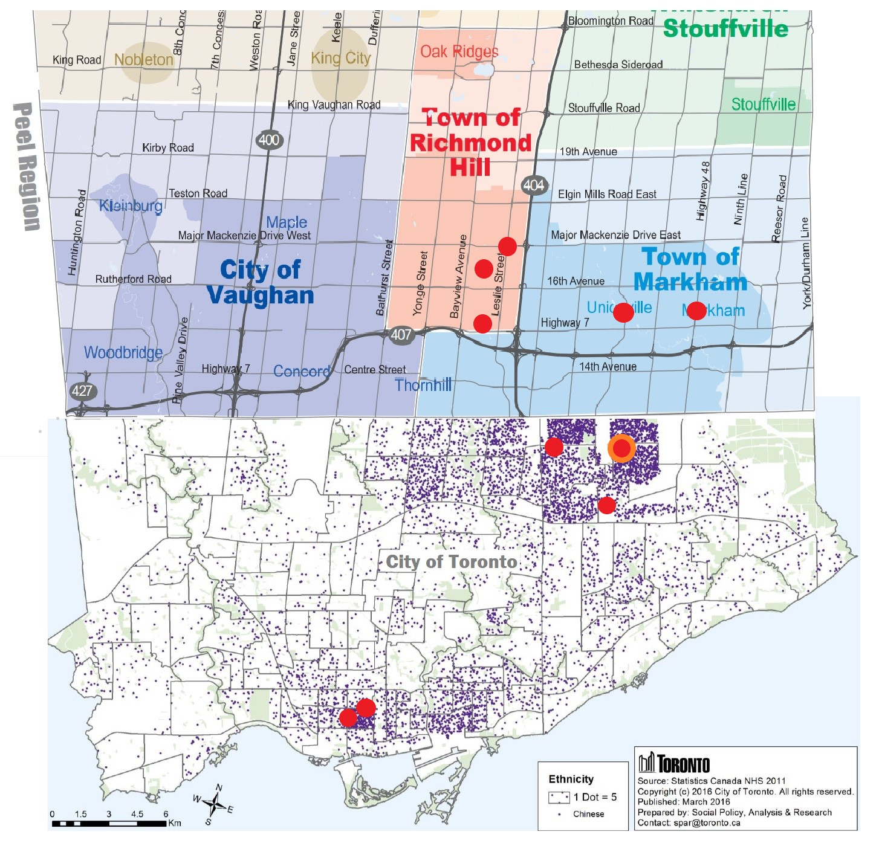
Chinese Seniors Population and Carefirst Service Sites

Slide 4
FACTORS INFORMING SERVICE DESIGN & PLANNING PROCESS
COMMUNITY NEEDS ASSESSMENT Client & Family Involvement
Influx of immigrants – 40% to 55% immigrants from Asian communities (Chinese and South Asians in Greater Toronto Areas, e.g. Markham and Scarborough
Caregivers’ burnout – complexity of care, difficulty in navigating the health care system
For retirees – needs for health/wellness programs and affordability of services
Stay longer & healthier at home and active community living
For complex care patients discharged from hospitals – shortened length of stay and inadequate home support after care
For immigrant seniors - adjustment and social isolation issues: coping with aging process and adjusting to new environment
For immigrant seniors – under utilization of home and community care services due to language and cultural differences

Slide 5



About Carefirst
Carefirst Seniors and Community Services Association
Providing a full range of community care services
Carefirst Foundation
Carefirst Family Health Team
Providing primary health care services
1976
2006
2007
THERE IS NO PLACE LIKE HOME

Slide 6
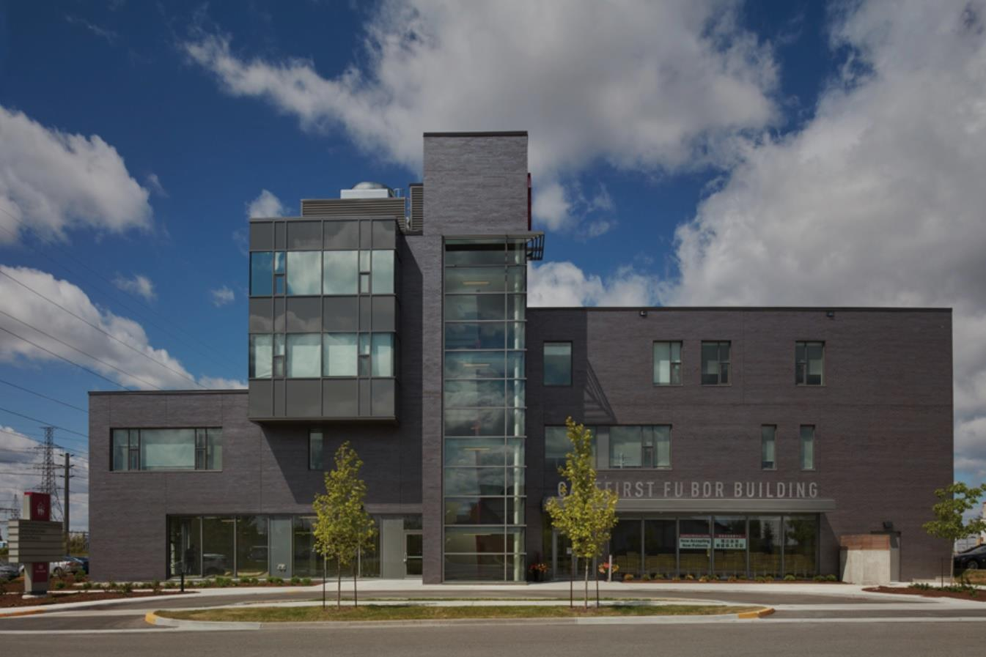

INTEGRATE™
The carefirst Solution
Recognizing the need for an integrated solution, Carefirst Seniors established INTEGRATE™–an innovative, data-driven solution that provides comprehensive, centre and home-based services to coordinate primary care and support services for seniors with chronic and complex health needs.
Wellness Programs
Community support services
Home
care
Primary
Care
Assisted living
Chronic
disease management
Adult
day program
Transitional care
OUR Life Approach Philosophy

Slide 7


INTEGRATE™
The carefirst Solution
1
Clients 55+ Years
InterRAI CHA/HC CAPS 12-20 & MAPLe Score 4+
Complex Care Needs
4
Designated Geographic Area
Use >2+ Services
Lives Independently with Supports
2
5
3
6
Specialist Clinics
I
interdisciplinary care
Navigation
Team Based Care
E-Connectivity
Grounded in Coordination Hubs
Resource Coordination
Accessibility
Timeliness
N
In home care
Family medicine
T
Intensive case management
E
Clients & Caregivers
G
R
Transitional care
Clinical
teams &
Adult Day
Program
A
T
Community services
E
ENGAGEMENT

Slide 8

Elderly Persons Centres/Adult Day Centres as
Navigation/Care Coordination Hubs
InTEGRATE Total Care Management
Community Development and Outreach
Adult Day Program
Wellness Education & Health Promotion
Assisted Living/ Supportive Housing
Exercise and Falls Prevention Program
Home Care Services
Volunteer Development and Coordination
Community Support Services – client intervention, transportation, friendly visiting
Short Stay Transitional Care
Chronic Disease Management & Prevention Program
Pharmacy/Rehab/Dental Office/Diagnostic Service
Chinese Elder Abuse Prevention
Bereavement Service
Virtual Education and Health Management Centre
Family Health Team and
Specialist Clinics
Vocational Training Centre
Partner Services
Geriatric Assessment and Intervention Network
Notes:
Helen presents
Home Care Services
Supportive Housing
Adult Day Programs
Volunteer Development and Coordination
Community Development & Outreach
Wellness Education & Health Promotion
Community Support Services; Elder Abuse Prevention; Chinese Bereavement Services
8

Slide 9
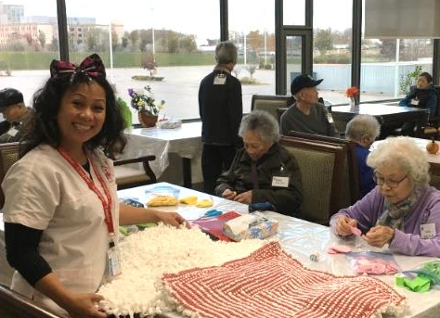
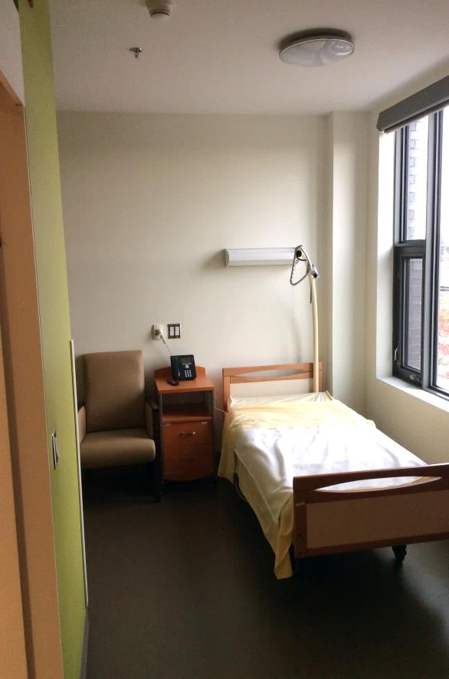
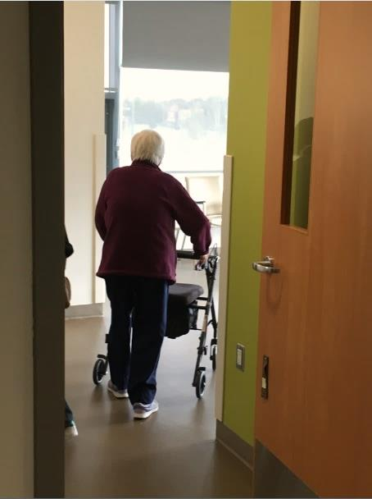

TRANSITIONAL CARE CENTRE
Carefirst's 30 -bed short stay respite and transitional care centre.
For hospital patients that no longer require acute care but would benefit from additional care, can be discharged directly to transitional care where they are supported socially, cognitive and functionally.
Transitional centre provides a gateway for patients to enter into INTEGRATE™ and fully access a range of other services that allows them to continue to live at home in the community.

Slide 10
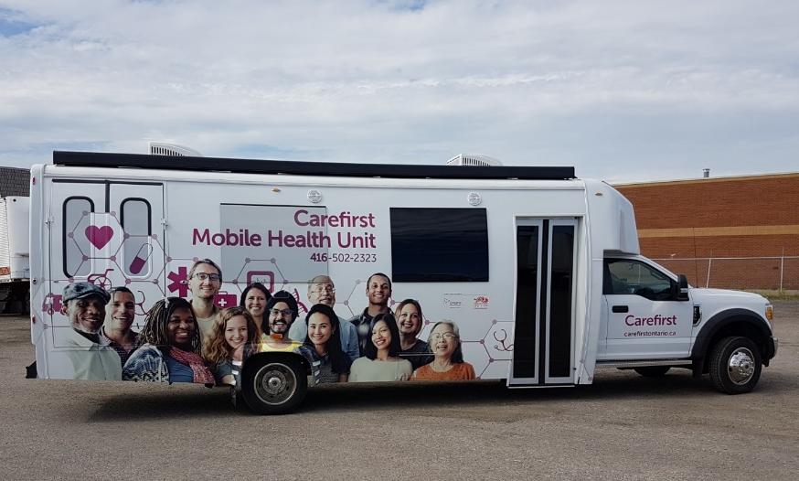
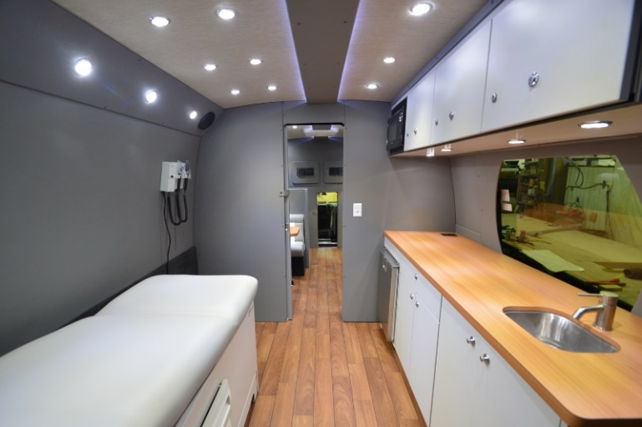
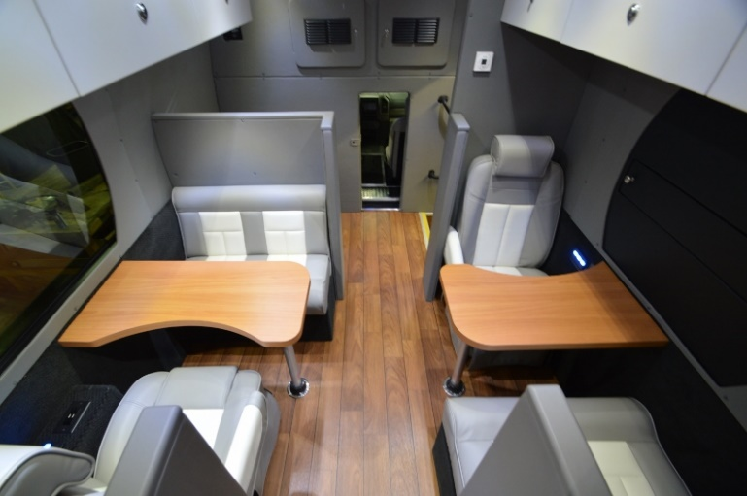
Mobile Health Unit to
Build Neighbourhoods of Care
To outreach and improve accessibility for the underserved seniors
To enhance health & wellness education in underserved area
To use modern device and technology to promote service accessibility and availability

Slide 11


INTEGRATE™
PRELIMINARY RESULTS
2.34%
Reported
Falls
3.84%
Reported
hospitalization
0.33%
Reported
Hospital
readmission in 7 days
0.17%
Reported
Hospital
readmission in 8-14 days
1.67%
Reported
ED Visits
98.3%
Client satisfaction
N = 599 Complex Needs Patients

Slide 12
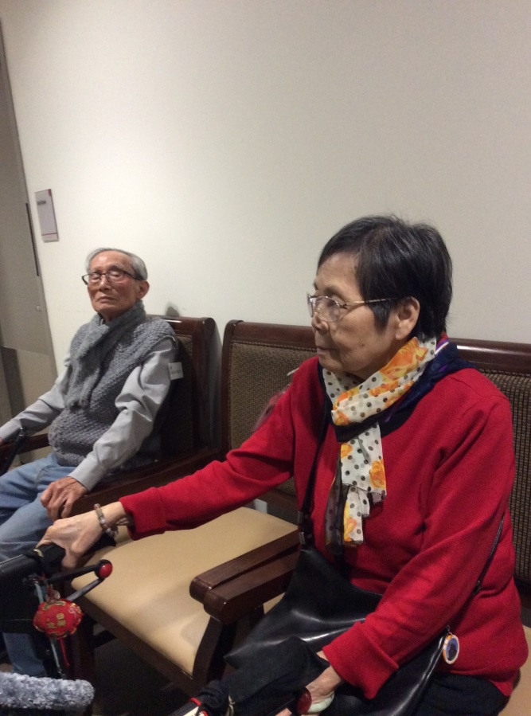
I’m lonely. My daughters don’t visit. I just stay all day in the apartment. I can’t do the things I used to. I feel so lonely.
Betty L.

Slide 13
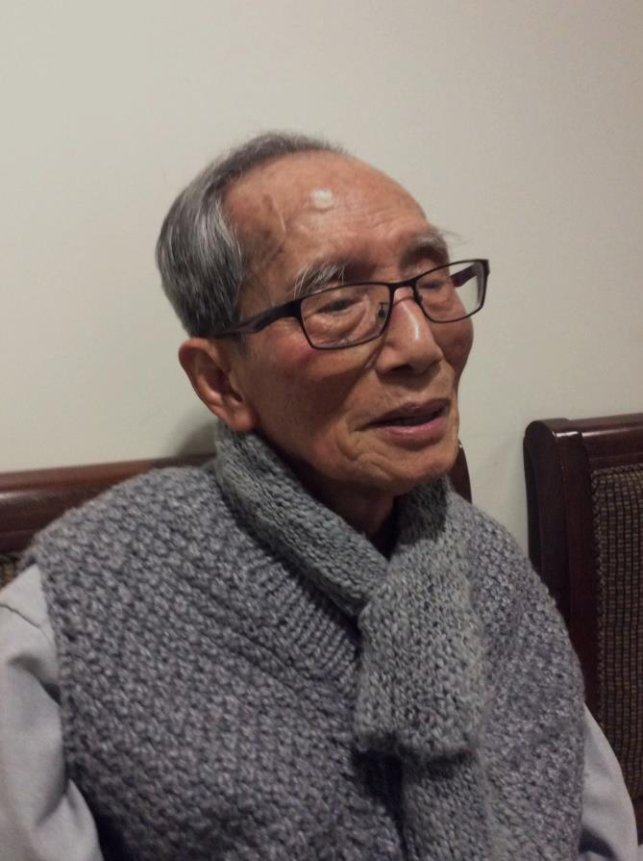

It's my job to take care of my wife but it's very hard. She fights me. She thinks I’m out to get her and she won’t take the pills or let me help her get ready. It’s hard to stay in all the time and it’s hard to
go out.
Stanley L.

Slide 14
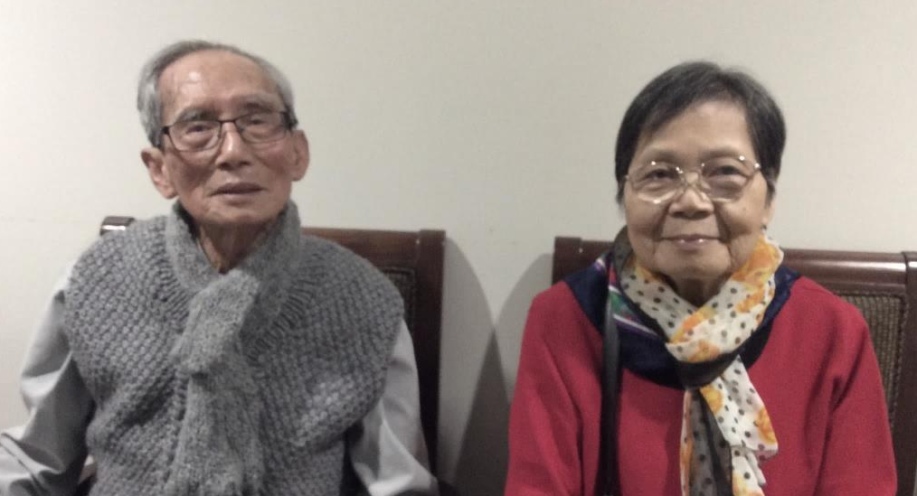
All the people are so good to me like (Carefirst ADP staff member) who plays the guitar and sings for us. She has a beautiful voice. It’s peaceful to hear the music.
Betty L.
I am so grateful to all the workers here. When she’s here (Adult Day Program), I can do jobs around the house and look after myself. She’s better with the pills…not so angry at me all the time. I can take her to the mall and we can finally meet up with friends again.
Stanley L.

Slide 15
Helen Leung, CEO
helen.leung@carefirstontario.ca
Website: http://carefirstontario.ca/

